Slide 1
IC Reports Framework
Presented By
Date: 30-Apr-2025

Slide 2

Framework Overview
Components
Rollout Strategy
Flexibility and Ongoing Maintenance
Skillset Required and Pre-requisite
Benefits, Effort Estimation and Cost
Compare and Contrast with Power BI
Transition Plan from PBI to ReactJS
Agenda

Slide 3
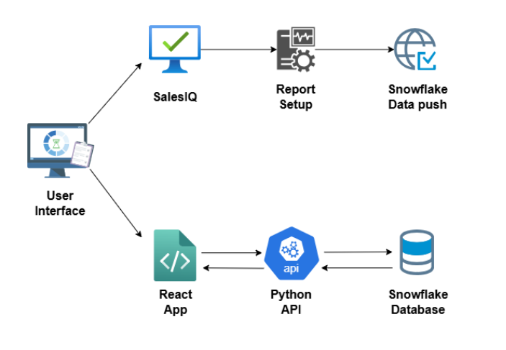
Framework Overview
Architecture
The Framework is built on the powerful React.js framework and leverages Highcharts for data visualization. This approach ensures high performance, interactive reports, and seamless user experience.
React.js is a JavaScript library for building user interfaces, while Highcharts is a charting library that provides a wide variety of interactive charts and graphs
Remarks: It integrates seamlessly with the existing IC configuration and report setup. There is no need for additional configuration or changes to the current setup of ‘Report Setup’ in SalesIQ.

Slide 4
Components
The framework uses a component-based architecture for efficient report creation. Reports are broken into reusable React Components, simplifying management and updates. This modular approach enhances maintainability and scalability, with components applicable to both SalesIQ web and UFE.
Steps to Follow
Identify Components
Develop Components
Assemble Components
Test Components
Current Components
HeaderSection1
Showcases essential report metadata like report title, reporting period, user information, and logos
HeaderSection2
Shows essential report metadata and allows users to switch between different views, e.g. ‘My View’, ‘Team Summary’
RHSPanel
To present specific content related to the report’s details
AdditionalNotes
To display list of additional notes

Slide 5
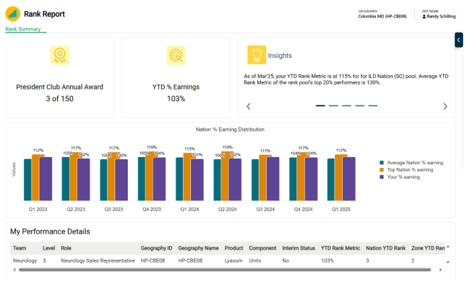
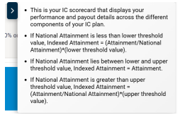
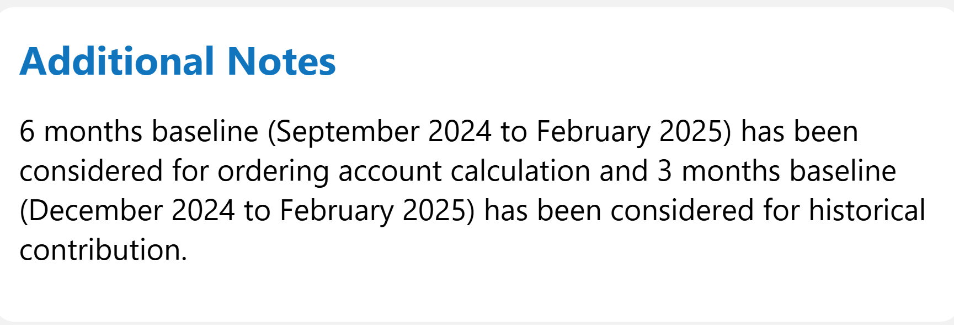
Components (cont.)
DataTable
For rendering tables with various interactive features, allowing users to view and manage data efficiently
Insights
Provides a dynamic and interactive way to display key insights related to the report
Chart
To display various charts using Highcharts, allowing users to visualize data in an interactive way
Example
HeaderSection
RHSPanel
Insights
AdditionalNotes
Chart
DataTable

Slide 6







Rollout Strategy
Identify
Data Sources
Develop Report Components
Integrate with IC Configuration
Test
the Report
Deploy
the Report
Examples of Current Implementations
BI-US Pilot: A pilot report for the Business Intelligence team in the US. The following React reports have been developed:
Weekly Performance Report
Scorecard
Goalcard
Rank Report
HCO HCP Report
What If Calculator
Ferring SIQ Implementation:
A report for the Ferring SIQ project. The following React reports have been developed:
Scorecard
Goalcard

Slide 7








Flexibility and Ongoing Maintenance
If there are changes to the plan, such as new requirements or updates to the existing reports, follow these steps:
Ongoing maintenance involves regular updates to the framework and reports to ensure they remain efficient and accurate. This includes:
Assess Impact
Monitor Performance of Reports
Update Component
Address Issues
Test Updates
Update Framework
Inform all stakeholders about change
Provide Training

Slide 8
Skillset Required and Pre-requisites
Associates working on these reports must have the following skills:
Before starting the development of new reports, ensure the following prerequisites are in place:
iPad (For Testing)
Salesforce Org Details
Server Details
IIS Server Enabled
Report Data Published
Domain to Host Python API and React App
Node.js Installed on Server
SMFT Credentials
Snowflake Credentials
Knowledge of IC Reports
React.js Skills
Highcharts Skills
Snowflake Knowledge
Python for APIs
Problem Solving
Communication Skill

Slide 9




Benefits, Effort Estimation and Cost
High Performance
Easy to Customize and Reuse
Cost-Effective
Look and Feel
Implementation Effort (when all Reports are in Legacy Setup):
Implementation Effort (when Reports are migrated from Golden Image with no Changes)
Task | Effort
Initial Setup (IT Tasks) | 5
Type (Per Report Effort) | Effort
React Report with DTR report setup (as per the components present in Library) | 5
React Report with Non DTR report setup (as per the components present in Library) | 6
React Report with small changes | 7
React Report with medium changes | 10
React Report with complex changes | On Demand
Task | Effort
Initial Setup (IT Tasks) | 5
Type (Per Report Effort) | Effort
React Report with DTR report setup (as per the components present in Library) | 6
React Report with Non DTR report setup (as per the components present in Library) | 6
Maintenance Effort | Cost Implications
Any changes or enhancements will be managed and implemented by React Development team | Requires two dedicated resources- front-end (React) and back-end developments Infrastructure access, server access, snowflake access, IIS admin access
Changes | Category
Font and color changes | Small
New chart configuration (time for POC) | Medium
Calculation logic change (IC Calculator) | Complex

Slide 10
Compare and Contrast with Power BI
Feature | React (With Components) | Power BI Embedded
Export to PDF/Excel | ✅ Included in Datatable component | ✅ Native
Print Views | ❌ Currently not supported. | ✅ Available out-of-box
Custom Format Downloads | ✅ Advanced filter functionality to the Datatable component | ⚠️ Limited to standard formats
Chart Variety | ✅ Chart component | ✅ Wide but predefined
Custom Design | ✅ Full freedom (branding, interactions) | ⚠️ Customization limited to themes
Dynamic/Interactive UIs | ✅ 100% possible | ✅ Built-in for standard interactions
Hover Details | ✅ Fully customizable | ✅ Native tooltips
Drill-down Navigation | ✅ You control logic (e.g., via router/state) | ✅ Built-in
Cross-chart Filtering | ✅ If implemented across components | ✅ Ready-made
Row-Level Security | ✅ Possible via backend logic | ✅ Native RLS support
User-Specific Filters | ✅ We're receiving user-specific filtered data in React from Snowflake. | ✅ Supported

Slide 11
Compare and Contrast with Power BI (cont.)
Feature | React (With Components) | Power BI Embedded
Whitelisting/IP Controls | ✅ We can handle it in salesforce | ✅ Controlled via Azure
Custom UX & Layout | ✅ Pixel-perfect freedom | ⚠️ Limited to PBI visual framework
Dev Time | 🚧 Relatively high | 🧩 Low, mostly configuration
Reusability | ✅ Each component is reusable. | ⚠️ Limited reusability/custom visuals
Embedded Analytics Flow | ✅ Seamless with React routing/state | ✅ Via iframe or API
Filter Panels | ✅ Custom design, can save state | ✅ Slicers available
Bookmarks/Views | ✅ Can build via user config saving | ✅ Native support
Cross-Filtering | ✅ Possible with state sync logic | ✅ Native
Per-user config (e.g., column select) | ✅ Easy via JSON configs/state mgmt. | ⚠️ Complex via bookmarks/APIs
White-labeling | ✅ Fully skinnable | ⚠️ Limited
Multi-tenant Custom Logic | ✅ Possible with smart component design | ⚠️ Needs complex Power BI setups

Slide 12





Transition Plan from PBI to ReactJS
Assessment of
Existing PBI Report
Identify
Data Sources
Report
Configuration
React Development Phase
Testing and Validation
Review Power BI report to understand data, KPIs, visuals, calculations, and filters.
Identify Power BI data sources.
Ensure data structure compatibility with ReactJS.
The IC Team will handle all Power BI setup changes, report conversions, and data structure updates.
Fetch Snowflake data using Python APIs and replicate the Power BI layout in ReactJS with components.
Test data rendering & UI performance with large datasets, ensuring a responsive, user-friendly experience on web & iPad.
Report Deployment Strategy | Follows the existing process
Multi-Tenancy Considerations | Follows the existing process
Customer Customization Capability | Includes business team-driven data configurations, these changes can be easily managed based on business requirements

